Slide 1
COMMUNITY YOUTH NEIGHBOURHOOD WALKS (within CHIEDZA process evaluation)
Youth researchers: McNelson Zulu and Mitchelle Mapisa
Mentors: Ranga Primrose Nyamwanza and Constance Mackworth-Young

Slide 2
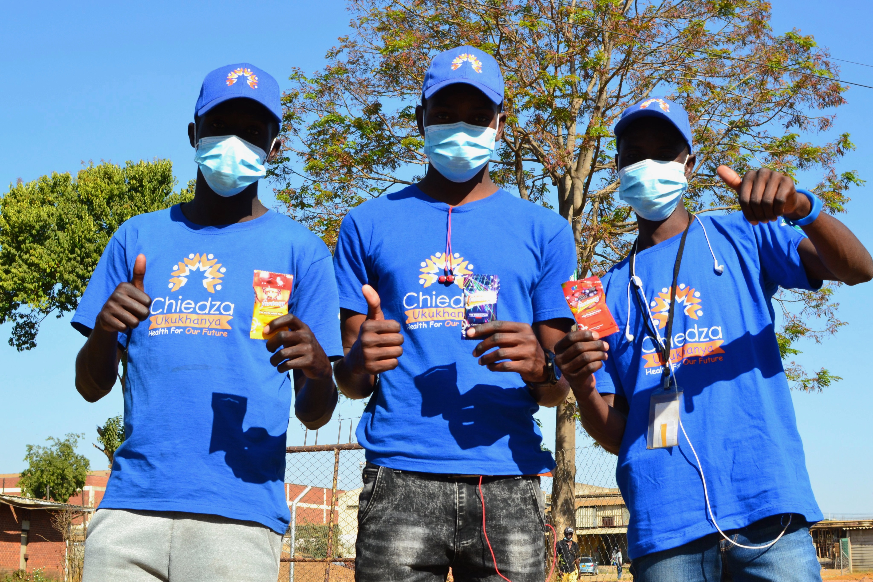
CHIEDZA
Community based interventions to improve HIV outcomes among young people.
Cluster randomized trial in 12 intervention and 12 control communities in 3 provinces in Zimbabwe.
Services offered to all young people aged 16 to 24 years in the intervention communities

Slide 3
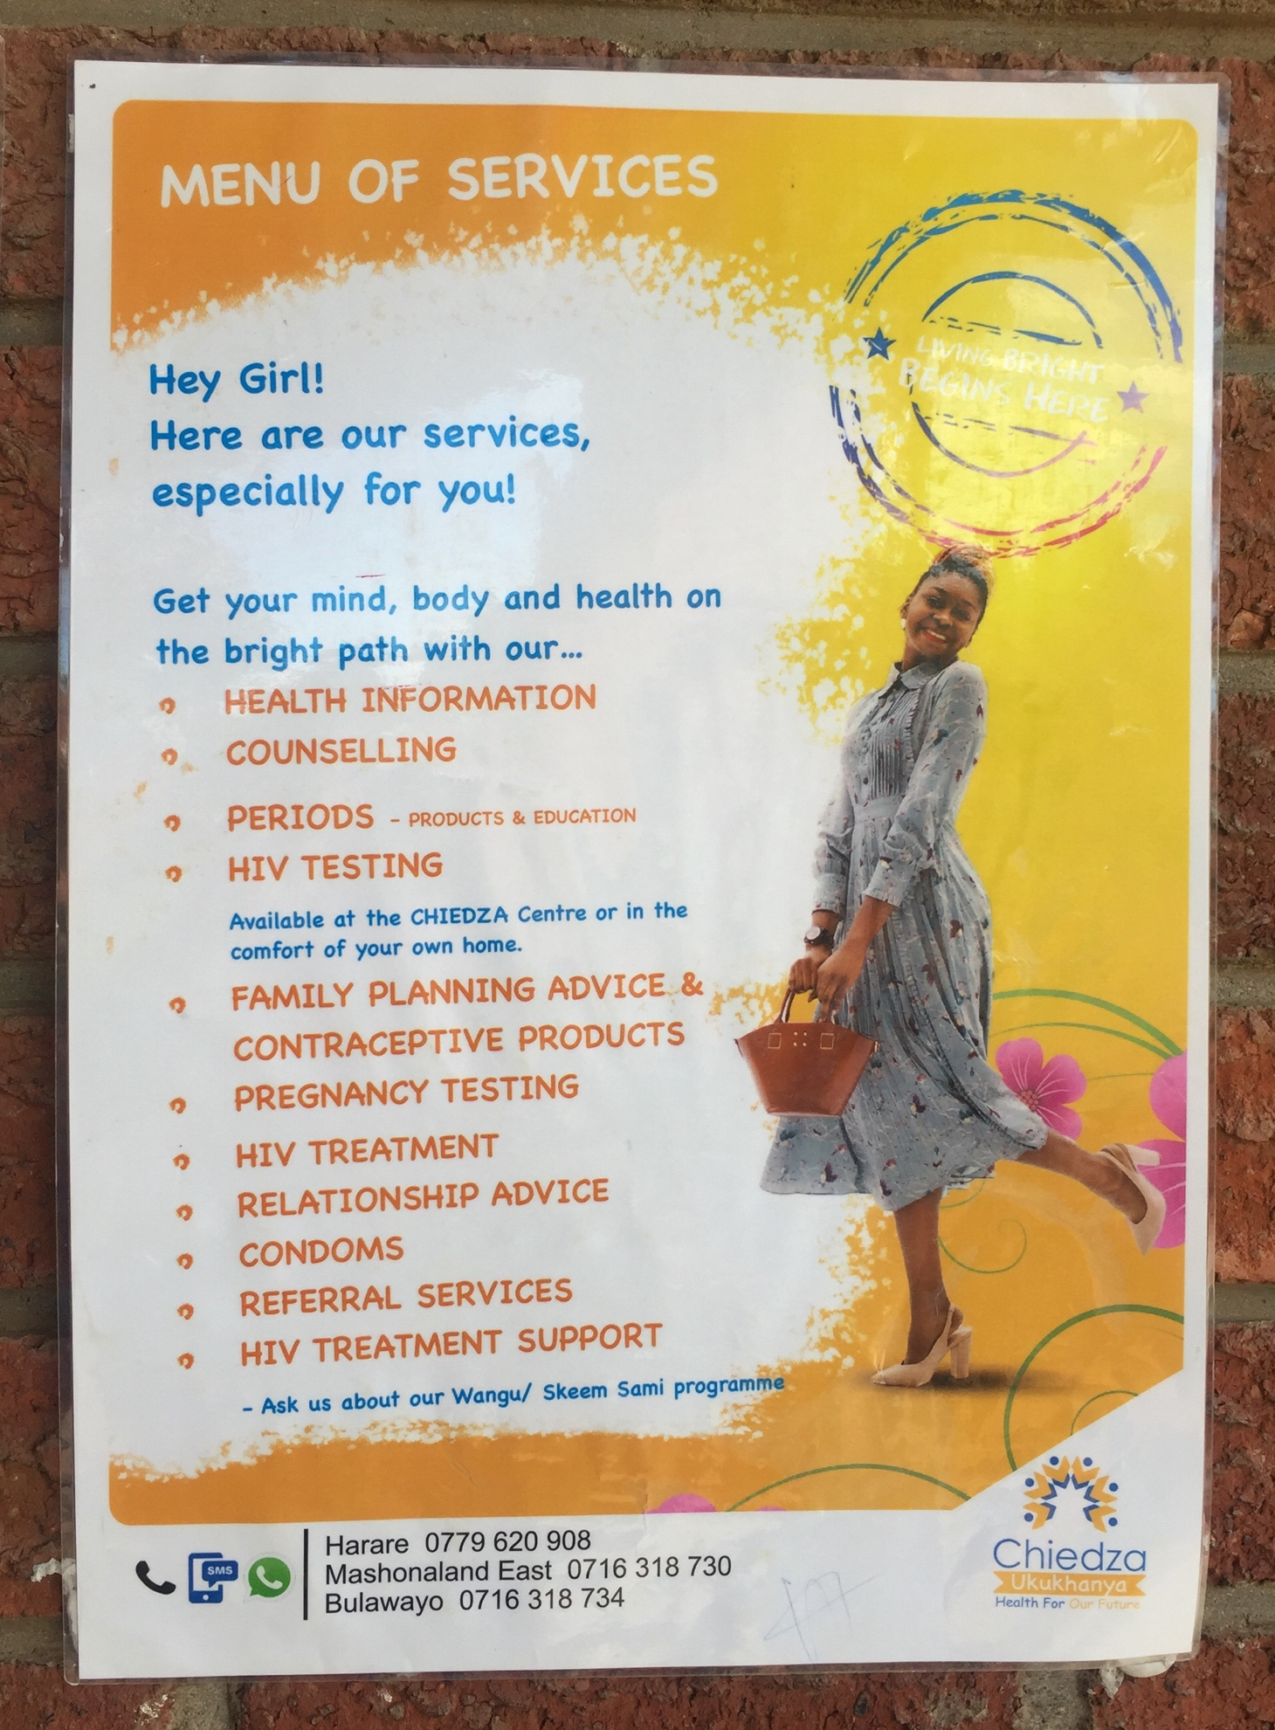
CHIEDZa
CHIEDZA offers services including:
HIV (testing, treatment and adherence support)
STI (testing and treatment)
Menstrual hygiene management (pads, cups and pants)
Male underpants
Family planning
Pregnancy testing
Condoms
Relationship advice and counselling
Youth friendly services (games)

Slide 4
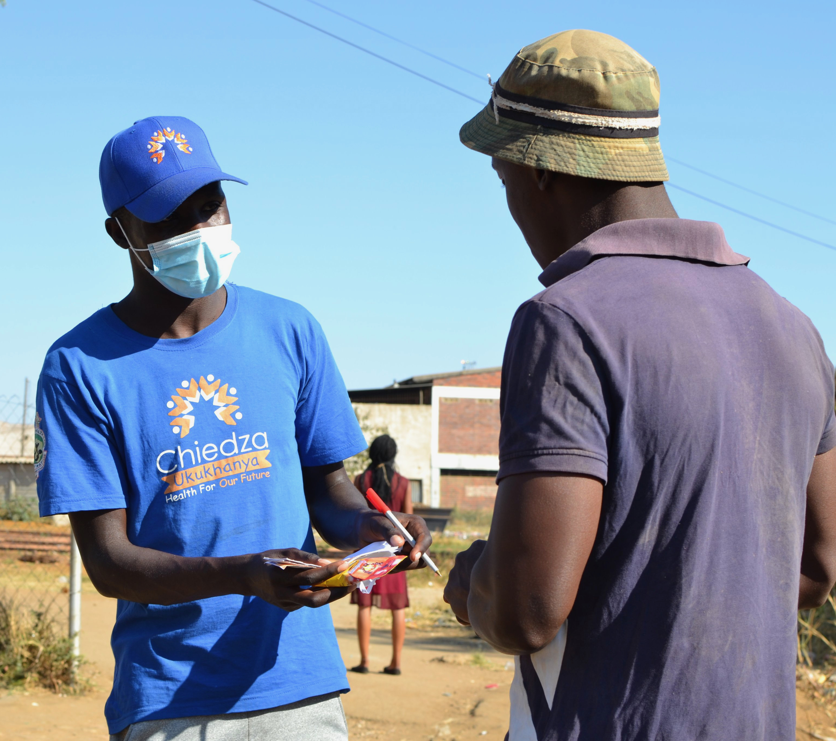
CHIEDZa
CHIEDZA: served a total of 38,130 eligible young people across the three provinces (as of August 2021)
But still some young people not reaching CHIEDZA
Either because they haven’t heard of CHIEDZA, or have heard but don’t want to come
Previous research in CHIEDZA has been with those coming to CHIEDZA. Gap in understanding of those not coming to CHIEDZA

Slide 5
Research QUESTIONS
Who is not coming to CHIEDZA from the CHIEDZA communities?
Why are some young people not coming to CHIEDZA?

Slide 6
AIM
To understand why some young people choose not to come to CHIEDZA.

Slide 7
METHODS

Slide 8
METHODS
We conducted neighbourhood walks around the CHIEDZA communities in Harare
Informal individual interviews
Group interviews with young people in these communities
Observations within CHIEDZA communities

Slide 9
Where?
CHIEDZA Harare communities:
Hatcliffe
Tafara
Warren park
Budiriro 1

Slide 10
Participants
Young people living in the CHIEDZA communities aged 16 to 24 (i.e. Those who would be eligible to attend CHIEDZA)

Slide 11
Questioning
Have you ever heard of CHIEDZA?
Have you ever been to CHIEDZA?
If yes, can you tell us when you last went?
If not, can you tell us the reason why you are not coming to CHIEDZA?

Slide 12
CHALLENGES, LESSONS AND EXPERIENCES
-WAY OF APPROACH
-STARTING A CONVERSATION
-CHANGING LOCATION
-CLUSTER BOUNDARIES
-REFUSAL
-FAKE AGE

Slide 13
BOUNDARIES Kambuzuma High School
Initially, we were not clear on the boundaries of the community, so we ended up going to areas where young people within our criteria were hard to reach. Within a space of 30 minutes, you wouldn’t find any young person moving around this road. Learning on the community boundaries.

Slide 14
Analysis
Analysis divided into three groups of participants
Never heard about CHIEDZA
Knew about CHIEDZA but never been there
Have been to CHIEDZA

Slide 15
FINDINGS

Slide 16
HAVE BEEN TO CHIEDZA
NEVER HEARD ABOUT CHIEDZA
KNEW ABOUT CHIEDZA BUT NEVER BEEN THERE
TOTAL PARTICIPANTS = 20
11 MALES = 55%
9 FEMALES = 45%
DISTANCE FROM THE CLUSTER
12 NEAR = 60%
6 FAR = 30%
2 ? = 10%
TOTAL PARTICIPANTS = 8
5 MALES = 62,5%
3 FEMALES = 37,5%
DISTANCE FROM THE CLUSTER
5 NEAR = 62,5 %
3 FAR = 37,5 %
TOTAL PARTICIPANTS = 14
6 MALES = 43%
8 FEMALES = 57%
DISTANCE FROM THE CLUSTER
5 NEAR = 36%
6 FAR = 43%
3 ? = 21%

Slide 17
HAVE BEEN TO CHIEDZA
PARTICIPANT | SEX | AGE | DISTANCE FROM THE CLUSTER
BUSY | FEMALE | 17 | BUDIRIRO 1 (FAR)
STILL GOES THERE | FEMALE | 17 | BUDIRIRO 1 (FAR)
STILL GOES THERE | FEMALE | 19 | BUDIRIRO 1 (NEAR)
RELOCATION | MALE | 17 | BUDIRIRO 1 (NEAR)
STILL GOES THERE | MALE | 23 | BUDIRIRO 1 (FAR)
LESS INFORMATION, LAZY | FEMALE | 21 | HATCLIFFE (NEAR)
RELOCATION, BUSY | MALE | 19 | HATCLIFFE (NEAR)
LAZY | FEMALE | 18 | TAFARA (NEAR)
STILL GOES THERE | FEMALE | 19 | TAFARA (FAR)
BUSY | FEMALE | 17 | TAFARA (FAR)
STILL GOES THERE | MALE | 20 | TAFARA (NEAR)
LAZY | MALE | 17 | TAFARA (NEAR)
BUSY | MALE | 20 | TAFARA
STILL GOES THERE | MALE | 22 | TAFARA (NEAR)
RELOCATION | MALE | 22 | TAFARA (NEAR)
STILL GOES THERE | MALE | 22 | TAFARA (NEAR)
STILL YOUNG FOR THE SREVICES | FEMALE | 16 | BUDIRIRO 1 (NEAR)
STILL HAS THEM | MALE | 22 | BUDIRIRO 1 (NEAR)
WASN’T AROUND | FEMALE | 20 | TAFARA (FAR)
BORED IN QUEUE | MALE | 16 | TAFARA

Slide 18
HAVE BEEN TO CHIEDZA
Many still go regularly, and value it as an important service
Others have been once or twice but haven’t been back, either because they are busy, lazy or relocated. One male said he was bored in the queue, so didn’t return. Others said they weren’t around or had moved for a period of time.

Slide 19
KNEW ABOUT CHIEDZA BUT NEVER BEEN THERE
PARTICIPANT | SEX | AGE | DISTANCE FROM THE CLUSTER
TAFARA | MALE | 22 | NEAR
TAFARA | MALE | 17 | NEAR
TAFARA | MALE | 23 | NEAR
WARREN PARK | MALE | 17 | NEAR
BUDIRIRO 1 | MALE | 19 | NEAR
HATCLIFFE | FEMALE | 17 | FAR
TAFARA | FEMALE | 21 | FAR
BUDIRIRO 1 | FEMALE | 16 | FAR

Slide 20
KNEW ABOUT CHIEDZA BUT HAVE NEVER BEEN
Busy
Shy
Not yet interested
Some only knew about CHIEDZA when it was explained what it offered, rather than knowing it by name.

Slide 21
NEVER HEARD ABOUT CHIEDZA
PARTICIPANT | SEX | AGE | DISTANCE FROM THE CLUSTER
BUDIRIRO 1 | FEMALE | 18 | FAR
BUDIRIRO 1 | MALE | 20 | FAR
TAFARA | FEMALE | 22 | NEAR
BUDIRIRO 1 | MALE | 22 | FAR
TAFARA | FEMALE | 16 | FAR
TAFARA | MALE | 17
TAFARA | MALE | 21 | FAR
TAFARA | MALE | 22 | NEAR
TAFARA | MALE | 17 | NEAR
WARREN PARK | FEMALE | 22 | FAR
TAFARA | FEMALE | 20 | NEAR
TAFARA | FEMALE | 18
WARREN PARK | FEMALE | 22 | NEAR
TAFARA | FEMALE | 18

Slide 22
Never heard about CHIEDZA
Higher proportion of young people who lived further from CHIEDZA centres

Slide 23
CONCLUSIONS

Slide 24
Conclusions
Those who have been to or heard of CHIEDZA largely valued it, and discussed the benefits they found CHIEDZA had had on their lives
Still quite a number of young people in CHIEDZA communities who don’t know about or haven’t accessed CHIEDZA services.
Particularly those who live further from CHIEDZA centres
Young men were most likely to have heard of CHIEDZA, but not attend
Being busy, lazy, shy about going, or mobile were key reasons that some young people didn’t go to CHIEDZA, even when they had heard of it.

Slide 25
Conclusions
Although mobilization strategy has increased reach and attendance at CHIEDZA, there are still a number of young people in CHIEDZA communities who CHIEDZA has not reached
Value in youth researchers for community-based research

Slide 26
THANK YOU!
#Chiedza!
#CommunityYouthNeighbourhoodWalks!

